Slide 1
Lecture 2: Syntax and Semantics Part A: Describing Syntax Part B: Describing Semantics
Chapter 3

Slide 2
Part A: Describing Syntax

Slide 3
Introduction
What is syntax? What does syntax describe?
Syntax: the form or structure of the expressions, statements, and program units
Syntax vs. Semantics
What is semantics? What does semantics describe?
Semantics: the meaning of the expressions, statements, and program units
Syntax and semantics provide a language’s definition
Users of a language definition
Other language designers
Implementers
Programmers (the users of the language)

Slide 4
Methods for Describing Syntax
Syntax Diagrams
Informal, used in early days
Formal descriptions
Context Free Grammar (CFG)
CS3110
Backus-Naur Form (BNF)
Equivalent to CFG
More readable notations
E.g. E -> EaT | T in CFG could be described in BNF as:
<Expr> -> <Expr> + <Term> | <Term>
Extended BNF (EBNF)
A non-recursive way (iterative way) to express CFG

Slide 5
Describing the syntax
Syntax diagram
Simple graphical representation, easy to read but not powerful enough to describe complexity in syntax, not support for compiler generator

Slide 6
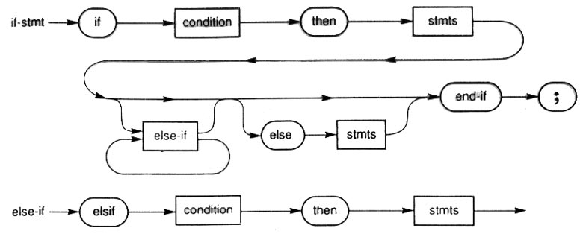
Syntax diagram: Example
More examples
Database SQL
Java syntax diagrams

Slide 7
BNF and Context-Free Grammars
Context-Free Grammars (CFG)
Developed by Noam Chomsky in the mid-1950s
Language generators, meant to describe the syntax of natural languages
Define a class of languages called context-free languages
CS3110: Formal Languages and Automata
Backus-Naur Form BNF
Invented by John Backus to describe Algol 58
Published in 1959
BNF is equivalent to context-free grammars

Slide 8
Sample BNF Rules
An abstraction (or nonterminal symbol) can have more than one RHS
<stmt> → <single_stmt>
| begin <stmt_list> end
<single_stmt> → …
<stmt_list> → …
A name inside <>, e.g. <stmt> is a nonterminal symbol to be defined

Slide 9
An Example Grammar
<program> → <stmts>
<stmts> → <stmt> | <stmt> ; <stmts>
<stmt> → <var> = <expr>
<var> → a | b | c | d
<expr> → <term> + <term> | <term> - <term>
<term> → <var> | const
Ambiguous and unambiguous grammars
The above is an ambiguous grammar
Details discussed in CS3110, omitted here.

Slide 10
Extended BNF (EBNF)
Optional parts are placed in brackets [ ]
<fun_call> -> ident ‘(‘[<expr_list>]’)’
Alternative parts of RHSs are placed inside parentheses () and separated via vertical bars |
<term> → <term> (+|-) const
Repetitions (0 or more) are placed inside braces { }
<ident> → letter {letter|digit}
Note: similar to regular expression notation

Slide 11
Example
The following are a few examples of function calls or a Java-like static method calls
f(); f(a, a+b); f(x*y, 3*x, 4);
From above we summarize the function call as:
A function name followed by (), or
A function name followed by a list of parameters inside the () where each parameter could be an expression.
Thus, the EBNF syntax rule for the function call could be
<fun_call> -> id ‘(‘[<expr_list>]’)’
Optional parts are placed in brackets [ ]
Parameters are optional

Slide 12
BNF and EBNF
BNF
<expr> → <expr> + <term>
| <expr> - <term>
| <term>
<term> → <term> * <factor>
| <term> / <factor>
| <factor>
EBNF
<expr> → <term> {(+ | -) <term>}
<term> → <factor> {(* | /) <factor>}

Slide 13
Recent Variations in EBNF
Alternative right-hand sides are put on separate lines
Note: we have followed this convention
Use of a colon : instead of =>
<expr> : <term> {(+ | -)_{oneof} <term>}
Use of _{opt} for optional parts
Use of oneof for choices
(For information only.)

Slide 14
Examples
Java Syntax Rules
Java Syntax by Oracle
Java Syntax Diagram and EBNF
Python Syntax Rules
Python 3 Syntax
Note: Since BNF no longer practically used, we now often use BNF referring to EBNF syntax description.

Slide 15
Interpreting Syntax Rules: if-stmt
Java Syntax Rules
Java Syntax by Oracle
Java Syntax Diagram and EBNF
Oracle:
IfThenStatement: if ( Expression ) Statement IfThenElseStatement: if ( Expression ) StatementNoShortIf else Statement IfThenElseStatementNoShortIf: if ( Expression ) StatementNoShortIf else StatementNoShortIf
Cui:
if_statement ::= "if" "(" expression ")" statement [ "else" statement ]

Slide 16
if (temperature >= 90) {
if (isSunny)
System.out.println(“Beach”);
} else
System.out.println(“Game”);
Today’s temperature is 80 and isSunny is True, what do you do?
A. Beach B. Game C. Nothing D. Other
Today’s temperature is 95 and isSunny is False, what do you do?

Slide 17
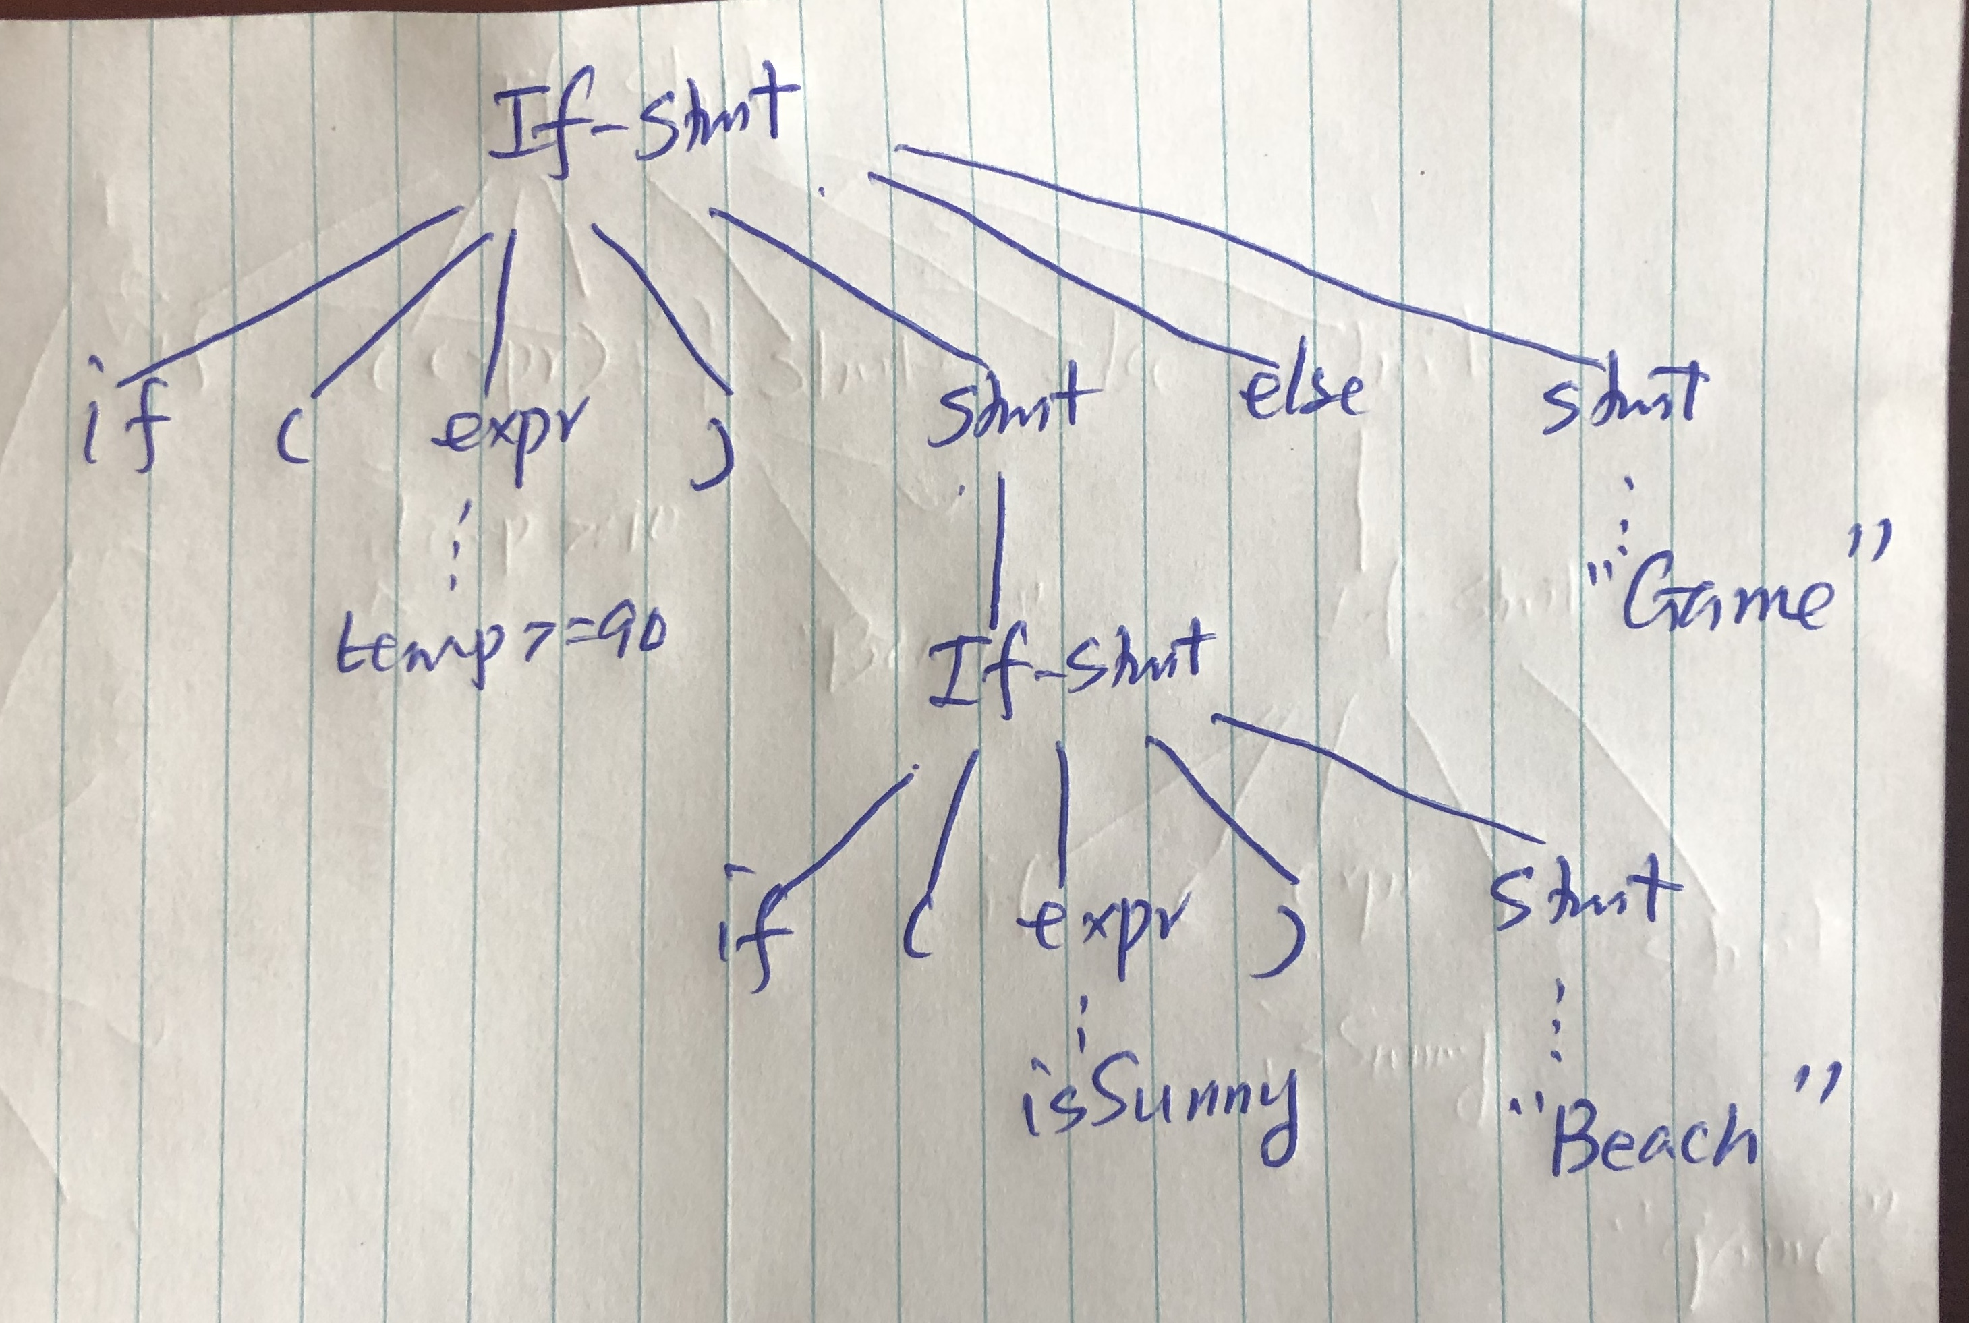
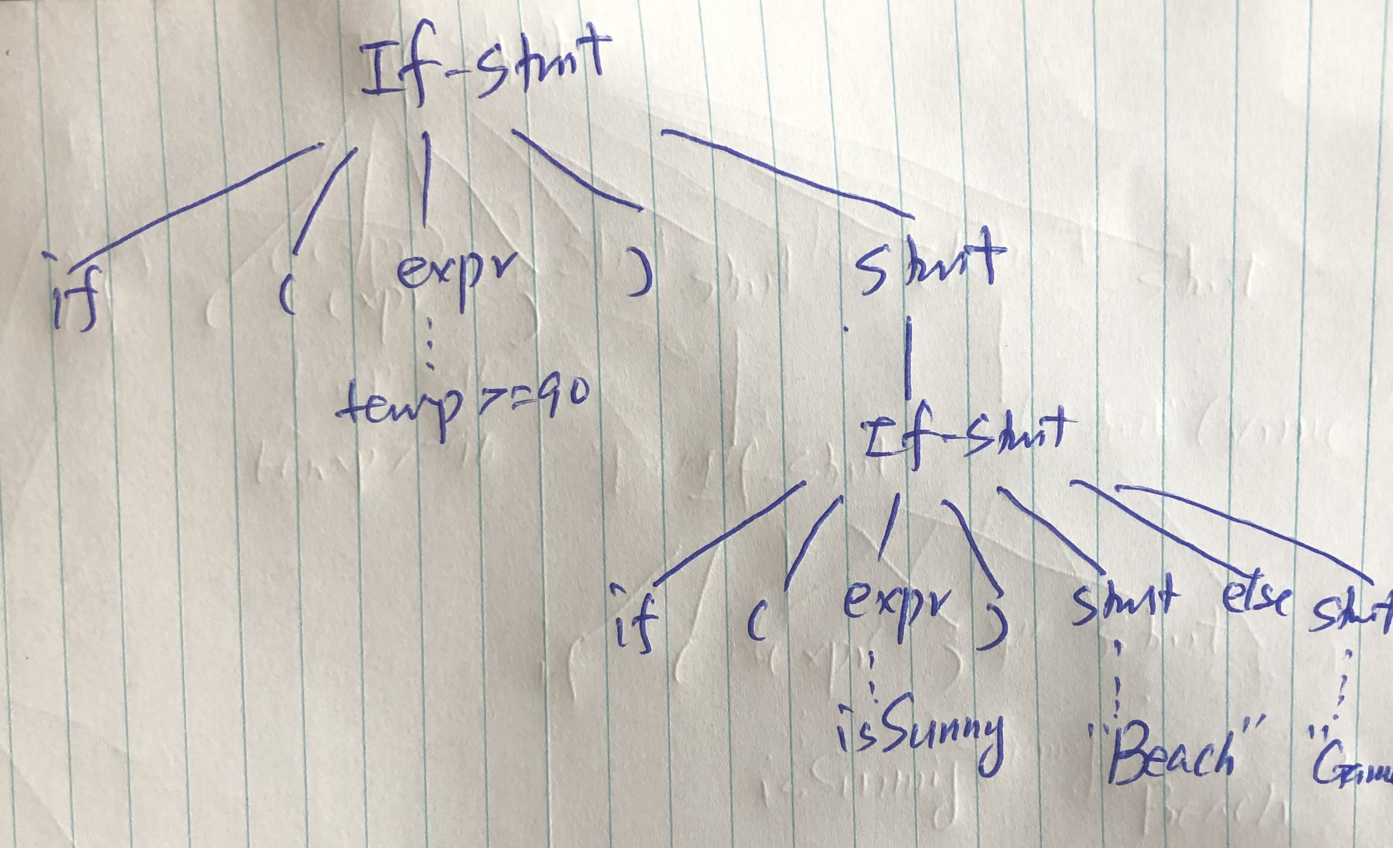

Slide 18
Strategies for resolving “dangling else”
Adding additional keyword
Ruby, VB
Pseudo code for demonstrating the concept
if (temperature >= 90)
if (isSunny)
“Beach”;
end if;
else
“Game”;
end if;
if (temperature >= 90)
if (isSunny)
“Beach”;
else
“Game”;
end if;
end if;

Slide 19
Strategies for resolving “dangling else”
Using indentation
Python
Pseudo code for demonstrating the concept
if temperature >= 90:
if isSunny:
“Beach”
else:
“Game”;
if temperature >= 90:
if isSunny:
“Beach”;
else:
“Game”;

Slide 20
Strategies for resolving “dangling else”
Requiring { } (block) for then & else branch
Go, Rust, Swift
Pseudo code for demonstrating the concept
if (temperature >= 90) {
if (isSunny) {
“Beach”;
}
else {
“Game”;
} //end of inside if
};
if (temperature >= 90) {
if (isSunny) {
“Beach”;
}
} //end of inside if
else {
“Game”;
};

Slide 21
Strategies for resolving “dangling else”
Writing unambiguous grammar or additional rule
Kotlin, C#, JavaScript
Same as Java
Syntax rule (e.g. Kotlin)
ifExpression (used by primaryExpression) :
'if' '(' expression ')’ (controlStructureBody | ';’) | 'if' '(' expression ')’ controlStructureBody? ';'? 'else' (controlStructureBody | ';’) ;
“else matches the closest if” or similar sentence
--Did you find it in language documentation?
--Some languages take this as de facto, not good.
--If part (2) syntax rule is an ambiguous grammar, must add additional note/rule to resolve the ambiguity
some may consider this addition as a semantic rule

Slide 22
Group Activity and Discussion
Find a (formal/trustable) document that describe the syntax of your group’s language in a EBNF or similar way (give a link to the document.)
Show the syntax rule for the if statement in your language
Rewrite the Java-like if statement (see next slide) in your group’s language
Check if your language’s syntax for if statement is ambiguous or not (i.e. able to produce two parse trees for the given if statement or not.)
If ambiguous, discuss how the language resolves the ambiguity
If not, discuss how the Java-like ambiguity is avoided

Slide 23
Java-like if statement
if (temperature >= 90) if (isSunny) System.out.println(“Beach”); else System.out.println(“Game”);

Slide 24
Summary
Syntax diagram is an easy, graphical method to describe syntax of ”simple” programming languages
BNF and context-free grammars are equivalent meta-languages
Well-suited for describing the syntax of programming languages
EBNF (now often simply referred to as BNF) is the method now popularly used to describe the syntax of programming languages.

Slide 25
Part B: Describing Semantics

Slide 26
Topics
Introduction
Attribute grammars
Syntax + semantics
Semantics descriptions
Operational semantics
Denotational semantics
Axiomatic semantics

Slide 27
Introduction
Semantics: the meaning of the expressions, statements, and program units
There is no single widely acceptable notation or formalism for describing semantics
Several needs for a methodology and notation for semantics:
Programmers need to know what statements mean
Compiler writers must know exactly what language constructs do
Correctness proofs would be possible
Compiler generators would be possible
Designers could detect ambiguities and inconsistencies

Slide 28
Describing Semantics
Attribute grammar
Syntax-directed translations
Operational semantics
Informal way of describing the semantics
Popularly used
Denotational semantics
Formal description of semantics
Axiomatic Semantics
Based on formal logic

Slide 29
Attribute Grammars: Concept
Semantic meanings (i.e. actions) associated with CFG rules
Limited power
Commonly used cases
Arithmetic expression evaluation
Type checking of expressions and statements
CS4110: Compilers and Interpreters
Discusses details of “syntax-directed translation”
In this class, we will give an example to illustrate the idea behind.

Slide 30
Example: Attribute Grammar for (simple) Arithmetic Expressions
Syntax | Semantics
E -> E1 + T | E.v = E1.v + T.v
E -> T | E.v = T.v
T -> T1 * F | T.v = T1.v * F.v
T -> F | T.v = F.v
F -> num | F.v = num.lexval
Notes:
For simplicity we use E, T, F instead of <Expr>, <Term>, <Factor>
E, E1 are same symbols in syntax, but need to distinguish them semantically (e.g. 3+4+8, 4+8 syntactically both are expressions, semantically they’re different, one means 15, the other 12.)
E.v here v is the attribute for symbol E. num.lexval refers to the lexical value of a number, e.g. 3 and 4 syntactically both are num but their lexical values are different.

Slide 31
Attributed Grammar: Semantics Analysis
Syntax Directed Translation
Evaluate semantic meaning/values along parse tree
Example:
Expression: 3 + 4 * 2
After lexical analysis: num + num * num
For semantic analysis, we need to distinguish the symbols, so
num1 + num2 * num3
Here we simply use num.v to refer to a number’s lexical value
num1.v = 3 num2.v = 4 num3.v = 2
Now we build a parse tree for num + num * num
And evaluate the semantic values along the parse tree

Slide 32
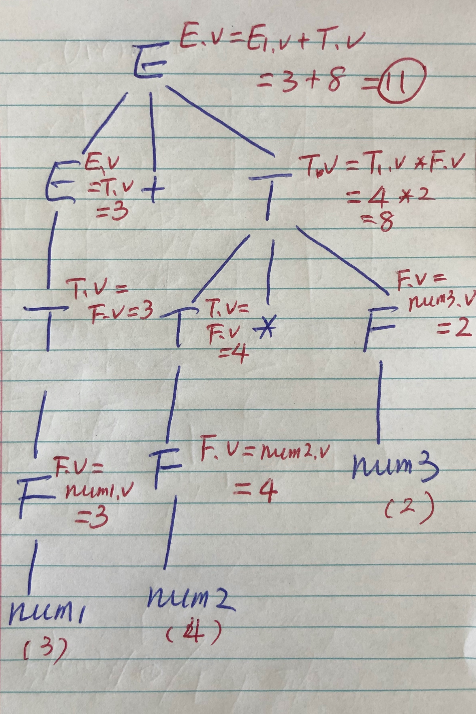
This illustrates that based on semantic rules defined in the attribute grammar, the meaning of 3+4*2 is 11.

Slide 33
Operational Semantics
Operational Semantics
Describe the meaning of a program by executing its statements on a machine, either simulated or actual. The change in the state of the machine (memory, registers, etc.) defines the meaning of the statement
Levels of uses
At the highest level, the interest is in the final result of the execution of a complete program, called natural operational semantics.
At the lowest level, operational semantics can be used to determine the precise meaning of a program through an examination of the complete sequence of state changes that occur when the program is executed, called structural operational semantics.

Slide 34
Basic Process
design an appropriate intermediate language
Here we use assembly like pseudo code as intermediate language, e.g.
a = b + c; //corresponds to an add instruction
if a < b goto L //corresponds to branch less than
goto L //corresponds to jump instruction
Translate HL program to low-level program
See next slide for example
The meaning of low-level program (as executed on an ideal machine) is the meaning/semantics of the high-level program

Slide 35
Operational Semantics – Example
Translate the following for-statement into assembly (pseudo-code)
HL code: count = 0
while (++count < max)
cost = cost +count * unit_price;
LL equivalence: (for illustration of basic idea, not optimized)
count = 0
Loop: count = count + 1
if count >= max goto Exit
temp = count * unit_price
cost = cost + temp
goto Loop
Exit:

Slide 36
Operational Semantics – Practice
Translate the following for-statement into assembly (pseudo-code)
for (count = 0; count < max; count ++)
cost = cost + count * unit_price;
(note: knowledge of CS2640 very helpful.)

Slide 37
Use case of operational semantics
In teaching programming languages
Particularly for 1st programming language
E.g. in explaining the meaning of a C++ for loop
C++ statement | meaning
for (expr1; expr2; expr3) { …stmts … } | expr1 Loop: v= expr2 if v == 0 goto Out … stmts … expr3 goto Loop Out:

Slide 38
Operational Semantics: Practice
Please define the meaning of a C++ if statement
if (a < b) {
count--;
sum += count * b;
}
else {
a *= b;
b /= count;
}

Slide 39
Denotational Semantics
Originally developed by Scott and Strachey (1970)
Based on recursive function theory
Provides a rigorous way to think about programs
The most abstract semantics description method
The basic idea is to recursively map the syntactic units to semantic domain which mimics memory states
Because of its complexity, of little use to language users
Details omitted here

Slide 40
Axiomatic Semantics
Based on formal logic (predicate calculus)
Original purpose: formal program verification
Axioms or inference rules are defined for each statement type in the language (to allow transformations of logic expressions into more formal logic expressions)
Recall inference rules from CS1300
The logic expressions are called assertions
Preconditions: prior to the assertion
Postconditions: after the assertion
The semantics of a program is a mapping from preconditions to postconditions
Details omitted here

Slide 41
Summary
An attribute grammar is a descriptive formalism that can describe both the syntax and the semantics of a language
Limited power in semantics description
Three primary methods of semantics description
Operational, denotational, axiomatic
Operational semantics widely used to (informally) describe the meaning of program constructs

Slide 42
Learning Objectives
After Lecture 3, you should be able to
Name the methods used to describe syntax and semantics
Explain the meaning of a BNF or EBNF rule
Write EBNF rules for simple language constructs
Discuss the ambiguity issues in language constructs
Translate simple Java-like statements into intermediate codes with equivalency in semantics

